Slide 1
Programming for problem solving
Presented by,
Devipriya M
Assistant professor
SRM IST Trichy

Slide 2
LISTS
The data type list is an ordered sequence which is mutable and made up of one or more elements.
Unlike a string which consists of only characters, a list can have elements of different data types, such as integer, float, string, tuple or even another list.
A list is very useful to group together elements of mixed data types.
Elements of a list are enclosed in square brackets and are separated by comma.
Like string indices, list indices also start from 0.

Slide 3
#list1 is the list of six even numbers
>>> list1 = [2,4,6,8,10,12]
>>> print(list1)
[2, 4, 6, 8, 10, 12]
#list2 is the list of vowels
>>> list2 = ['a','e','i','o','u']
>>> print(list2)
['a', 'e', 'i', 'o', 'u']

Slide 4
#list3 is the list of mixed data types
>>> list3 = [100,23.5,'Hello']
>>> print(list3)
[100, 23.5, 'Hello']
#list4 is the list of lists called nested
>>> list4 =[['Physics',101], ['Chemistry',202], ['Maths',303]]
>>> print(list4)
[['Physics', 101], ['Chemistry', 202], ['Maths', 303]]

Slide 5
Accessing Elements in a List
The elements of a list are accessed in the same way as characters are accessed in a string.
#initializes a list list1
>>> list1 = [2,4,6,8,10,12]
>>> list1[0] #return first element of list1
2
>>> list1[3] #return fourth element of list1
8
#return error as index is out of range
>>> list1[15]
IndexError: list index out of range

Slide 6
#an expression resulting in an integer index
>>> list1[1+4]
12
>>> list1[-1] #return first element from right
12
#length of the list list1 is assigned to n
>>> n = len(list1)
>>> print(n)
6
#return the last element of the list1
>>> list1[n-1]
12
#return the first element of list1
>>> list1[-n]
2

Slide 7
Lists are Mutable
In Python, lists are mutable. It means that the contents of the list can be changed after it has been created.
#List list1 of colors
>>> list1 = ['Red','Green','Blue','Orange']
#change/override the fourth element of list1
>>> list1[3] = 'Black'
>>> list1 #print the modified list list1
['Red', 'Green', 'Blue', 'Black']

Slide 8
LIST OPERATIONS
Concatenation
Python allows us to join two or more lists using concatenation operator depicted by the symbol +.
#list1 is list of first five odd integers
>>> list1 = [1,3,5,7,9]
#list2 is list of first five even integers
>>> list2 = [2,4,6,8,10]
#elements of list1 followed by list2
>>> list1 + list2
[1, 3, 5, 7, 9, 2, 4, 6, 8, 10]

Slide 9
Repetition
Python allows us to replicate a list using repetition operator depicted by symbol *.
>>> list1 = ['Hello']
#elements of list1 repeated 4 times
>>> list1 * 4
['Hello', 'Hello', 'Hello', 'Hello']

Slide 10
Membership
Like strings, the membership operators in checks if
the element is present in the list and returns True, else
returns False.
>>> list1 = ['Red','Green','Blue']
>>> 'Green' in list1
True
>>> 'Cyan' in list1
False

Slide 11
Membership
The not in operator returns True if the element is not
present in the list, else it returns False.
>>> list1 = ['Red','Green','Blue']
>>> 'Cyan' not in list1
True
>>> 'Green' not in list1
False

Slide 12
Slicing
Like strings, the slicing operation can also be applied
to lists.
>>> list1 =['Red','Green','Blue','Cyan',
'Magenta','Yellow','Black']
>>> list1[2:6]
['Blue', 'Cyan', 'Magenta', 'Yellow']
#list1 is truncated to the end of the list
>>> list1[2:20] #second index is out of range
['Blue', 'Cyan', 'Magenta', 'Yellow',
'Black']
>>> list1[7:2] #first index > second index
[] #results in an empty list

Slide 13
TRAVERSING A LIST
We can access each element of the list or traverse a list using a for loop or a while loop.
>>> list1 = ['Red','Green','Blue','Yellow','Black']
>>> for item in list1:
print(item)
Output:
Red
Green
Blue
Yellow
Black

Slide 14
Another way of accessing the elements of the list is
using range() and len() functions:
>>> for i in range(len(list1)):
print(list1[i])
Output:
Red
Green
Blue
Yellow
Black

Slide 15
>>> list1 = ['Red','Green','Blue','Yellow',
'Black']
>>> i = 0
>>> while i < len(list1):
print(list1[i])
i += 1
Output:
Red
Green
Blue
Yellow
Black

Slide 16
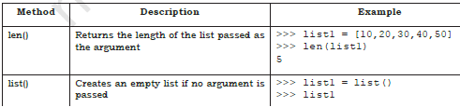
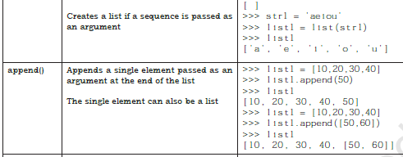
BUILT IN METHODS

Slide 17
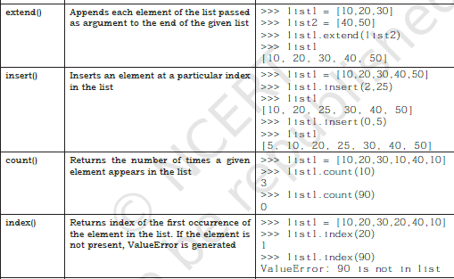

Slide 18
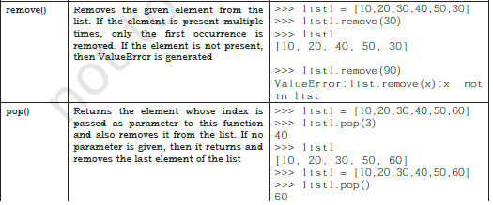

Slide 19
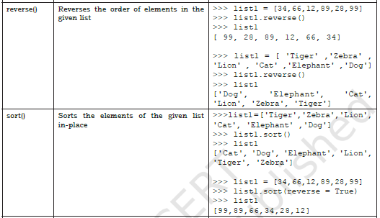

Slide 20
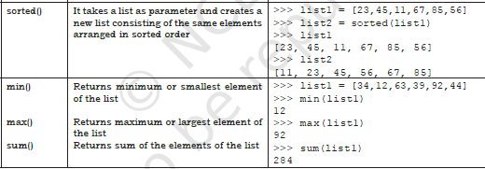

Slide 21
NESTED LISTS
When a list appears as an element of another list, it is called a nested
>>> list1 = [1,2,'a','c',[6,7,8],4,9]
#fifth element of list is also a list
>>> list1[4]
[6, 7, 8]
>>> list1[4][1]
7
#index i gives the fifth element of list1
#which is a list
#index j gives the second element in the
#nested list

Slide 22
COPYING LISTS
>>> list1 = [1,2,3]
>>> list2 = list1
>>> list1
[1, 2, 3]
>>> list2
[1, 2, 3]
>>> list1.append(10)
>>> list1
[1, 2, 3, 10]
>>> list2
[1, 2, 3, 10]

Slide 23
COPYING LISTS
The statement list2 = list1 does not create a new list.
Rather, it just makes list1 and list2 refer to the same list object.
Here list2 actually becomes an alias of list1.
Therefore, any changes made to either of them will be reflected in the other list.
We can also create a copy or clone of the list as a distinct object by three following methods.

Slide 24
We can slice our original list and store it into a new variable as follows:
newList = oldList[:]
>>> list1 = [1,2,3,4,5]
>>> list2 = list1[:]
>>> list2
[1, 2, 3, 4, 5]

Slide 25
We can use the built-in function list() as follows:
newList = list(oldList)
>>> list1 = [10,20,30,40]
>>> list2 = list(list1)
>>> list2
[10, 20, 30, 40]

Slide 26
We can use the copy () function as follows:
import copy #import the library copy
#use copy()function of library copy
newList = copy.copy(oldList)
>>> import copy
>>> list1 = [1,2,3,4,5]
>>> list2 = copy.copy(list1)
>>> list2
[1, 2, 3, 4, 5]

